Slide 1
A system call is a programmatic way in which a computer program requests a service from the kernel of the operating system it is executed on. A system call is a way for programs to interact with the operating system.
System call provides the services of the operating system to the user programs via Application Program Interface(API).
A user program can interact with the operating system using a system call. A number of services are requested by the program, and the OS responds by launching a number of systems calls to fulfill the request.

Slide 2
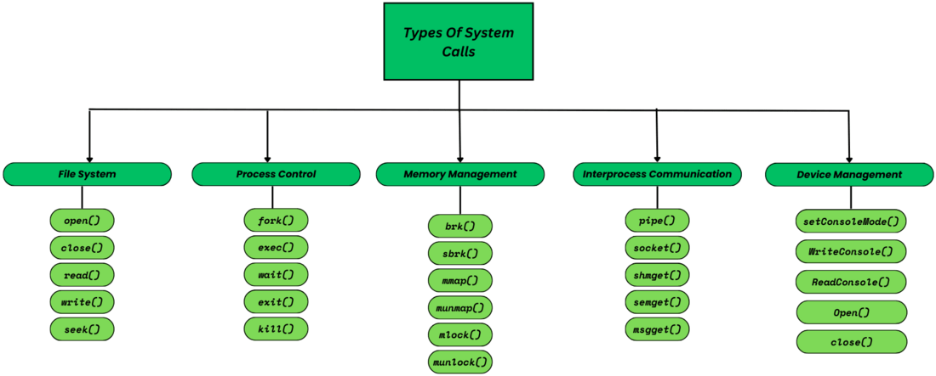

Slide 3
File System Operations
These system calls are made while working with files in OS, File manipulation operations such as creation, deletion, termination etc.
open(): Opens a file for reading or writing. A file could be of any type like text file, audio file etc.
read(): Reads data from a file. Just after the file is opened through open() system call, then if some process want to read the data from a file, then it will make a read() system call.
write(): Writes data to a file. Wheneve the user makes any kind of modification in a file and saves it, that’s when this is called.
close(): Closes a previously opened file.
seek(): Moves the file pointer within a file. This call is typically made when we the user tries to read the data from a specific position in a file. For example, read from line – 47. Than the file pointer will move from line 1 or wherever it was previously to line-47.

Slide 4
Process Control
These types of system calls deal with process creation, process termination, process allocation, deallocation etc. Basically manages all the process that are a part of OS.
fork(): Creates a new process (child) by duplicating the current process (parent). This call is made when a process makes a copy of itself and the parent process is halted temporarily until the child process finishes its execution.
exec(): Loads and runs a new program in the current process and replaces the current process with a new process. All the data such as stack, register, heap memory everything is replaced by a new process and this is known as overlay. For example, when you execute a java byte code using command – java “filename”. Then in the background, exec() call will be made to execute the java file and JVM will also be executed.
wait(): The primary purpose of this call is to ensure that the parent process doesn’t proceed further with its execution until all its child processes have finished their execution. This call is made when one or more child processes are forked.
exit(): It simply terminates the current process.
kill(): This call sends a signal to a specific process and has various purpose including – requesting it to quit voluntarily, or force quit, or reload configuration.

Slide 5
Memory Management
These types of system calls deals with memory allocation, deallocation & dynamically changing the size of a memory allocated to a process. In short, the overall management of memory is done by making these system calls.
brk(): Changes the data segment size for a process in HEAP Memory. It takes an address as argument to define the end of the heap and explicitly sets the size of HEAP.
sbrk(): This call is also for memory management in heap, it also takes an argument as an integer (+ve or -ve) specifying whether to increase or decrease the size respectively.
mmap(): Memory Map – it basically maps a file or device into main memory and further into a process’s address space for performing operations. And any changes made in the content of a file will be reflected in the actual file.
munmap(): Unmaps a memory-mapped file from a process’s address space and out of main memory
mlock() and unlock(): memory lock defines a mechanism through which certain pages stay in memory and are not swapped out to the swap space in the disk. This could be done to avoid page faults. Memory unlock is the opposite of lock, it releases the lock previously acquired on pages.

Slide 6
Interprocess Communication (IPC)
When two or more process are required to communicate, then various IPC mechanism are used by the OS which involves making numerous system calls. Some of them are :
pipe(): Creates a unidirectional communication channel between processes. For example, a parent process may communicate to its child process through a pipe making a parent process as input source of its child process.
socket(): Creates a network socket for communication. Processes in same or other networks can communicate through this socket, provided that they have necessary network permissions granted.
shmget(): It is short for – ‘shared-memory-get’. It allows one or more processes to share a portion of memory and achieve interprocess communication.
semget(): It is short for – ‘semaphore-get’. This call typically manages the coordination of multiple processes while accessing a shared resource that is, the critical section.
msgget(): It is short for – ‘message-get’. IPC mechanism has one of the fundamental concept called – ‘message queue’ which is a queue data structure inside memory through which various processes communicate with each other.

Slide 7
Device Management
The device management system calls are used to interact with various peripherial devices attached to the PC or even the management of the current device.
SetConsoleMode(): This call is made to set the mode of console (input or output). It allows a process to control various console modes. In windows, it is used to control the behaviour of command line.
WriteConsole(): It allows us to write data on console screen.
ReadConsole(): It allows us to read data from console screen
open(): This call is made whenever a device or a file is opened. A unique file descriptor is created to maintain the control access to the opened file or device.
close(): This call is made when the system or the user closes the file or device.

Slide 8
1)Write a Program using fork() system call to create 2 child nodes of the same process ie one parent process p having 2 child process c1 and c2
P
C1
C2

Slide 9
#include<stdio.h>
#include<sys/types.h>
#include<sys/wait.h>
#include<unistd.h>
int main()
{
int pid, c1, c2;
c1 = fork();
if (c1 == 0)
{
printf("pid number of child c1 is %d\n", getpid());
printf("pid number of parent of c1 is %d\n", getppid());
}
else
{
wait(NULL);
c2 = fork();

Slide 10
if (c2 == 0)
{
printf("pid number of second child is %d\n", getpid());
printf("pid number of parent of c2 is %d\n", getppid());
}
else
{
wait(NULL);
printf("pid of parent process is %d\n", getpid());
}
}
return 0;
}

Slide 11
2)Write a program using fork() system call to create multilevel process.
P
C1
C2

Slide 12
#include <stdio.h>
#include <sys/types.h>
#include <unistd.h>
#include <sys/wait.h>
int main() {
int pid1, pid2;
// Create the first child process
pid1 = fork();
if (pid1 < 0) { // Fork failed
printf(stderr, "Fork failed\n");
return 1;
} else if (pid1 == 0) { // Child process
printf("First child process created: PID = %d, Parent PID = %d\n", getpid(), getppid());
}

Slide 13
// Create the second child process from the first child
pid2 = fork();
if (pid2 < 0) { // Fork failed
printf(stderr, "Fork failed\n");
return 1;
} else if (pid2 == 0) { // Second child process
printf("Second child process created: PID = %d, Parent PID = %d\n", getpid(), getppid());
} else { // Parent process of the second child
wait(NULL); // Wait for the second child to finish
printf("Parent process of the second child: PID = %d\n", getpid());
}
} else { // Parent process
wait(NULL); // Wait for the first child to finish
printf("Parent process: PID = %d\n", getpid());
}
return 0;
}

